Slide 1
Göttelab report
240527
UNC_UC-London
Shipment #1
Targets: SARS-2; h-mtRNAP
Screening and IC50

Slide 2
UNC_UC-London
Shipment #1
<10% inhibition at 100 uM
<10% inhibition at 100 uM
<1% inhibition at 100 uM
- horizontal solid blue line illustrates the level of inhibition of SARS-2 RdRp activity observed during the screening experiments at 100 uM

Slide 3
DATA:
Screening

Slide 4
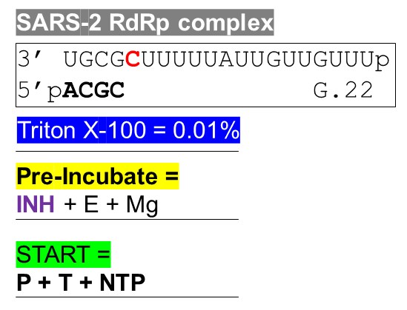
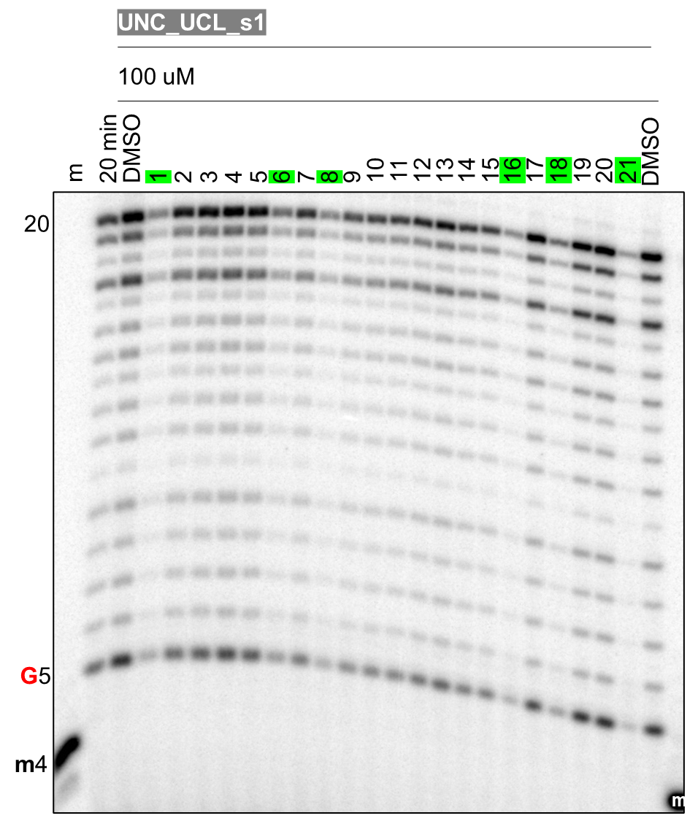

Slide 5
DATA:
IC50 with SARS-2

Slide 6
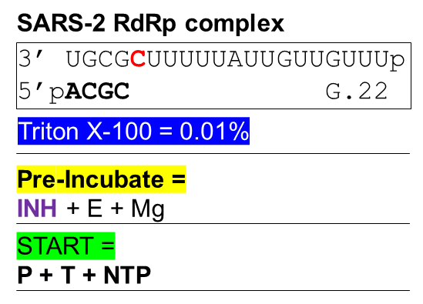
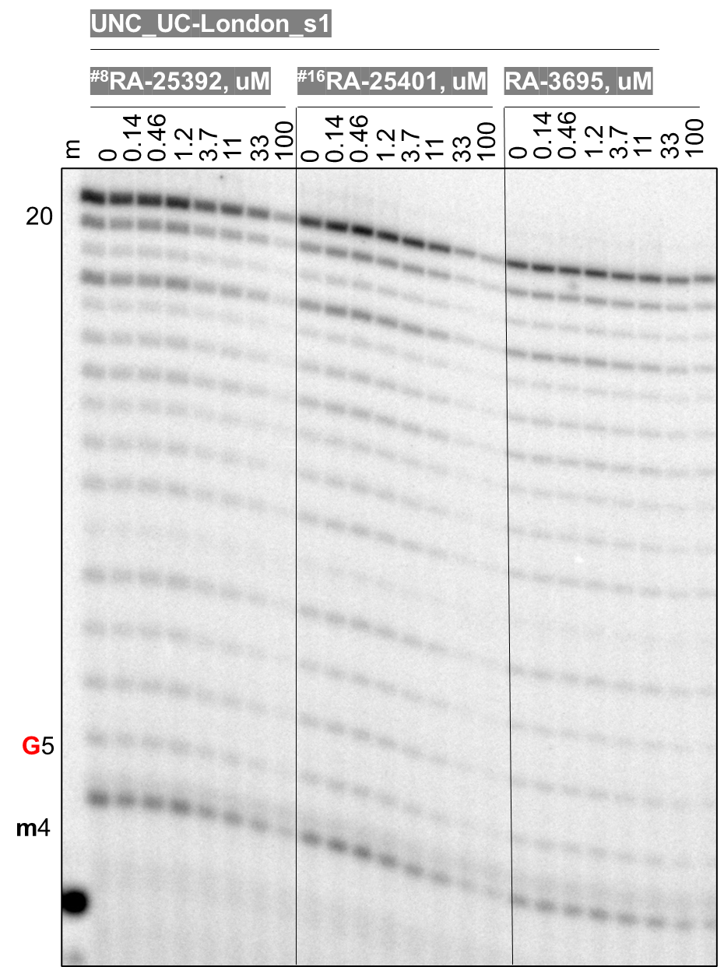

Slide 7
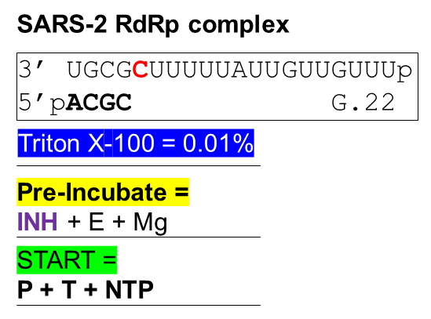
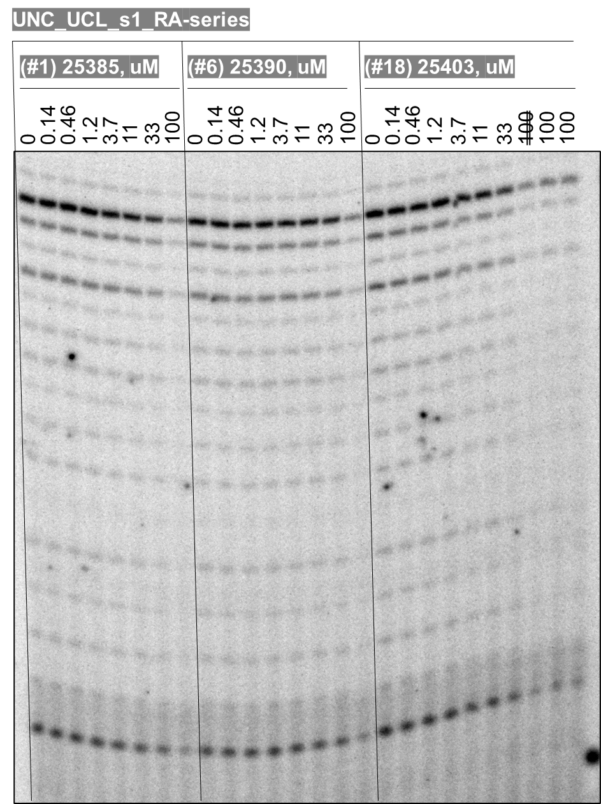

Slide 8
DATA:
h-mtRNAP

Slide 9
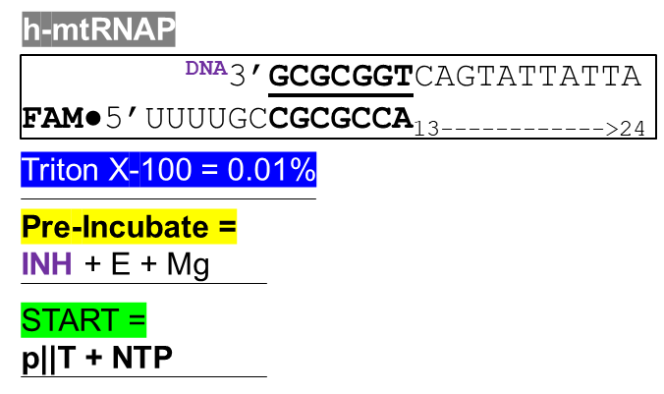
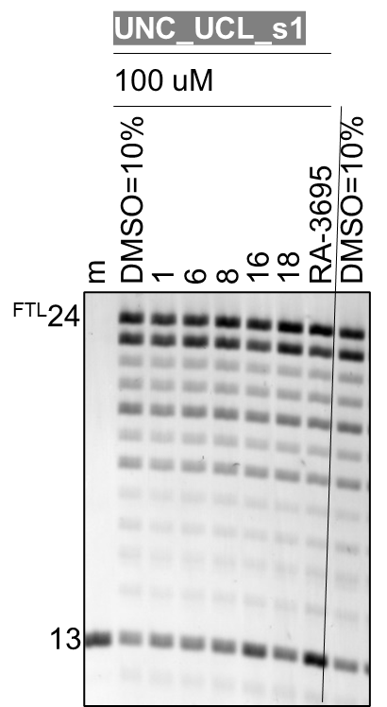

Slide 10

